Slide 1



CORONAVIRUS ANALYSIS USING SQL
by Digvijay Surve

Slide 2

TABLE OF CONTENTS
02
DATASET
OVERVIEW
01
INTRODUCTION &
PROBLEM STATEMENT
03
DATA EXPLORATION
04
GEOGRAPHIC ANALYSIS

Slide 3


INTRODUCTION & PROBLEM STATEMENT
The coronavirus pandemic has reshaped daily life globally. This analysis of coronavirus data using SQL aims to uncover key insights into its spread and demographic impacts. Join us to explore critical aspects of the pandemic and understand its implications for decision- making and response strategies.

Slide 4


DATASET OVERVIEW

Slide 5



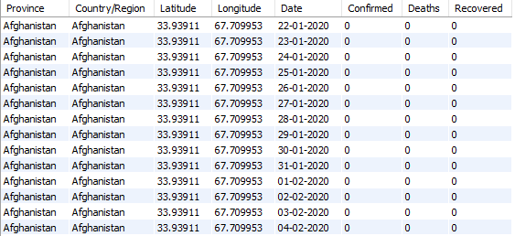


DATASET OVERVIEW

Slide 6


Province: Geographic subdivision within
a country/region.
Country/Region: Geographic entity where
data is recorded.
Latitude: North-south position on Earth's
surface.
DATASET OVERVIEW
Longitude: East-west position on Earth's
surface.
Date: Recorded date of CORONA VIRUS
data.
Confirmed: Number of diagnosed
CORONA VIRUS cases.
Deaths: Number of CORONA VIRUS
related deaths.
Recovered: Number of recovered
CORONA VIRUS cases.

Slide 7

DATA EXPLORATION

Slide 8
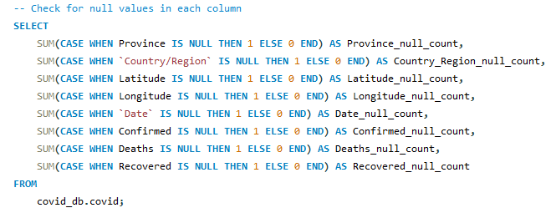
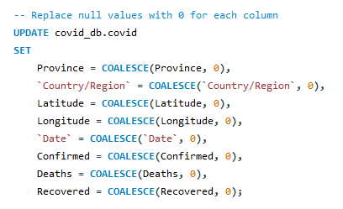

IDENTIFYING & REPLACING NULL VALUES

Slide 9

78,386
ROWS IN TOTAL!

Slide 10
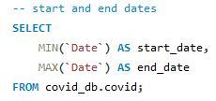

START AND END DATES
2020/01/22
2021/06/13

Slide 11
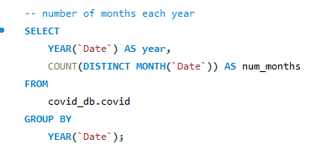

NUMBER OF MONTHS
2020
2021
12
months
6
months

Slide 12

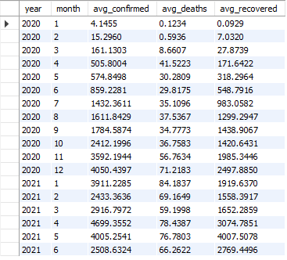
MONTHLY AVERAGE
APRIL,2021
4699.3552
CONFIRMED
JANUARY,2021
84.1837
DEATHS
MAY,2021
4007.5078
RECOVERY

Slide 13
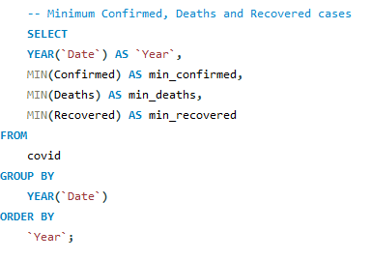

YEARLY MINIMUM CASE RATES
0
NO DEATHS!

Slide 14

11,23,456
MAX RECOVERY IN 2020!
YEARLY MAXIMUM CASE RATES
7,374
MORE DEATHS IN 2021!

Slide 15
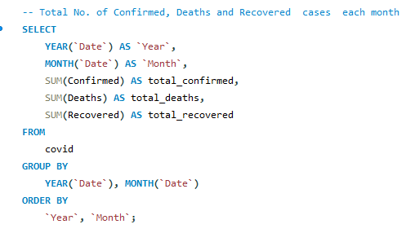
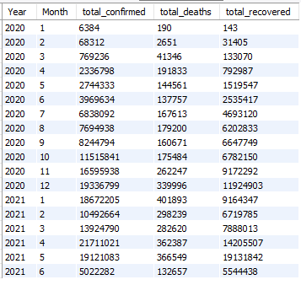
MONTHLY TOTAL CASES

Slide 16
MONTHLY TOTAL CASES
CONFIRMED CASES
RECOVERY CASES
1,93,36,799
DECEMBER, 2020
1,19,24,903
DECEMBER, 2020
DEATH CASES
33,996
DECEMBER, 2020

Slide 17
MONTHLY TOTAL CASES
CONFIRMED CASES
RECOVERY CASES
2,17,11,021
APRIL,2021
1,42,05,507
APRIL, 2021
DEATH CASES
4,01,893
JANUARY,2021

Slide 18
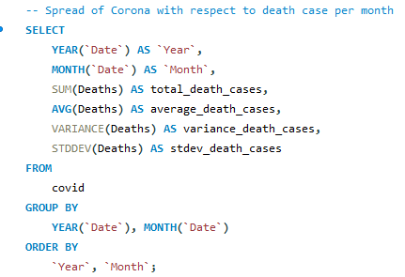
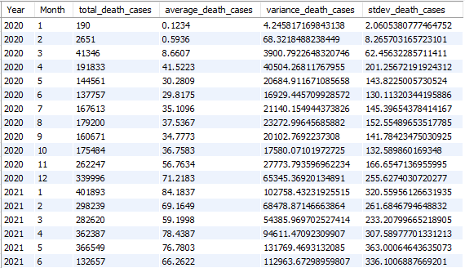
CORONAVIRUS SPREAD WITH RESPECT TO MONTHLY DEATH CASES

Slide 19


CORONAVIRUS SPREAD WITH RESPECT TO MONTHLY DEATH CASES
MAY, 2021
~363
HIGHEST SPREAD!

Slide 20
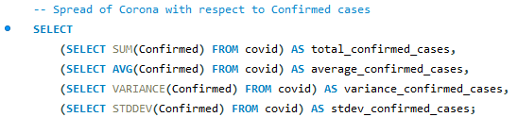
CORONAVIRUS SPREAD WITH RESPECT TO CONFIRMED CASES

Slide 21
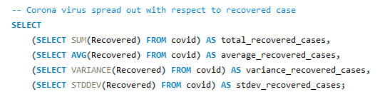
CORONAVIRUS SPREAD WITH RESPECT TO RECOVERY CASES

Slide 22


16,90,65,144
11,30,89,548
CONFIRMED TO RECOVERY
IN TOTAL

Slide 23













GEOGRAPHIC ANALYSIS

Slide 24

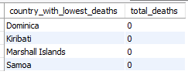
COUNTRIES HAVING HIGHEST CONFIRMED CASE AND LOWEST DEATH CASE
HIGHEST CONFIRMED CASES
LOWEST DEATH CASES

Slide 25
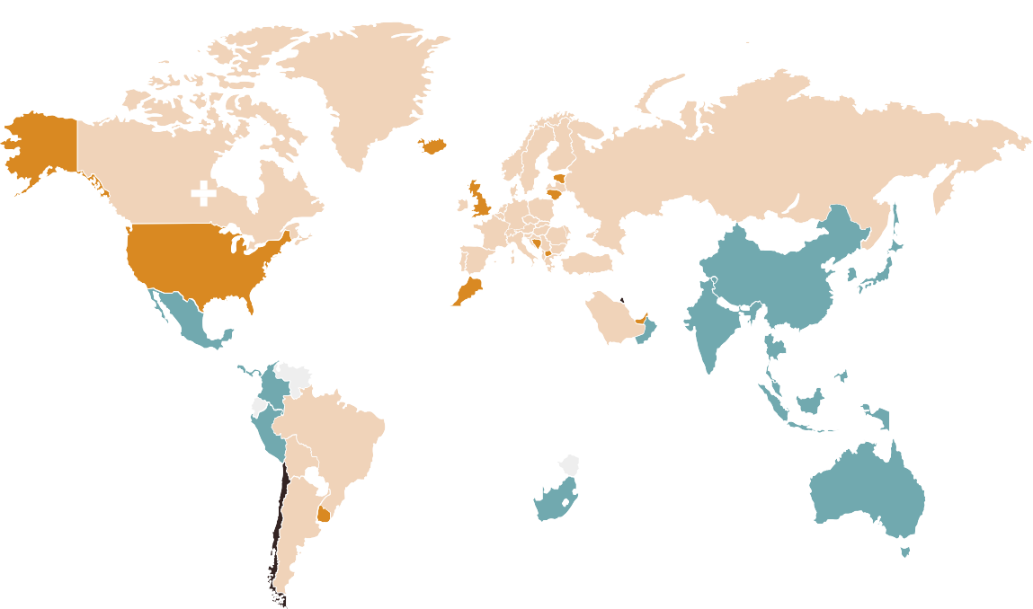
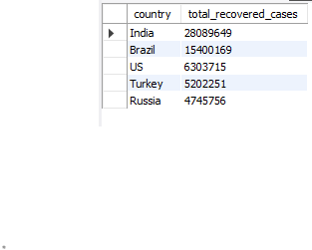

TOP 5 COUNTRIES WITH HIGHEST RECOVERY CASES

Slide 26





USEFUL INSIGHTS

Slide 27



USEFUL INSIGHTS
Year 2021 with the most critical cases!
Directing focus towards the Countries with lowest recovery
rates and highest deaths.
Focusing on medical priorities in countries with highest
confirmed cases.
Emphasizing the time of year with highest spread of virus to find out the key conditions behind.

Slide 28





THANKS!
CREDIľS: ľkis pícsckťaťiok ťcmplaťc was cícaťcd b; Slidcsgo, ikcludikg icoks b; Ilaťicok, akd ikrogíapkics & imagcs b; Iíccpik.

